Slide 1
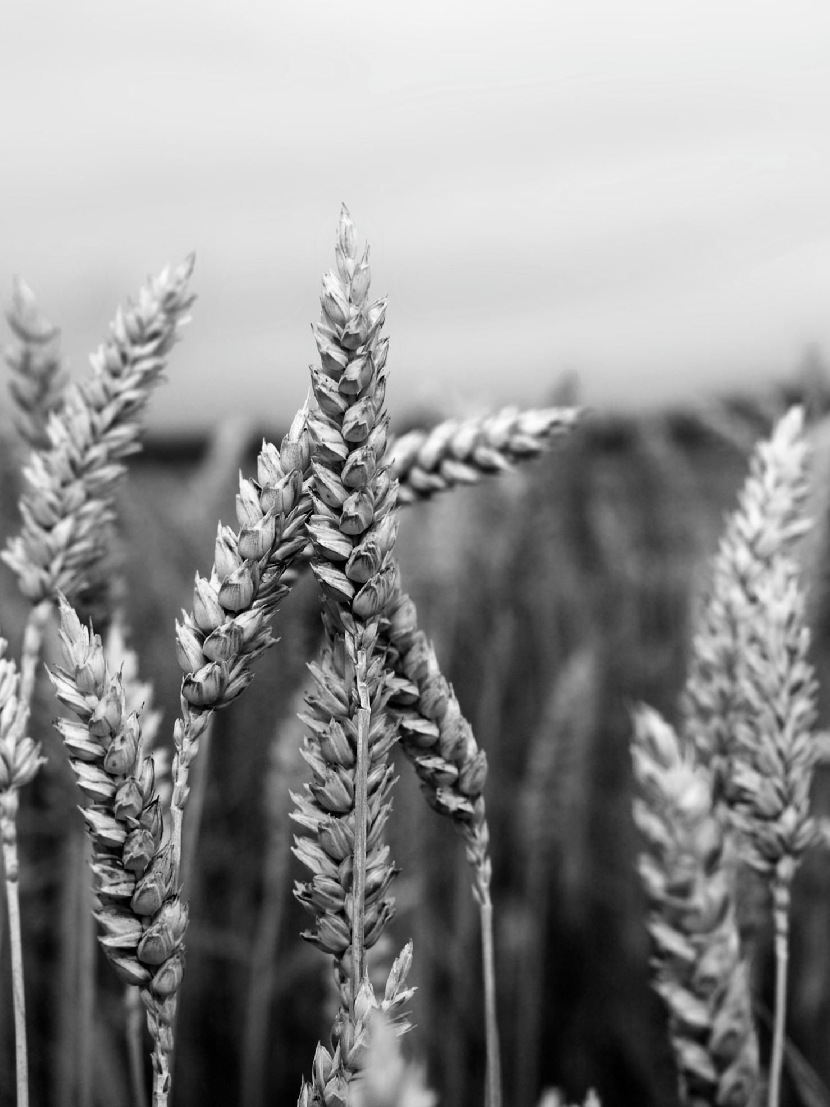

fayp
®
Fostering Agri-Culture
Among Young People

Slide 2





Guidelines
to attract young people
to agriculture
Made by
®
In cooperation with
With the financial support of
This document reflects only the view of the FAYP partners.
The European Commission is not responsible for any use that may be made of the information it contains.

Slide 3
The target of these guidelines are social partners in agriculture. They flow from discussions and exchange of best practises within the FAYP project.
The main goal of FAYP is to promote dialogue among employers’ associations on their role to foster youth employment
and entrepreneurship
in agriculture.

Slide 4

Main policy
pillars
1
Education
2
Communication
3
Ease doing business

Slide 5
Educate
to make
the primary sector
“primary” for young people

Slide 6
1
Promoting integration between education institutions
and the rural world
Because the lack of integration between the two worlds is one of the reasons behind the scant involvement of young people in agriculture
INSTRUMENTS
School-to-work transition and dual learning programmes, including internship and apprenticeship schemes
School and university lectures held by agricultural/agri-food entrepreneurs
Joint initiatives, e.g. contests, summer schools, guided tours, workshops, scholarships

Slide 7
Best practice
by CAP
The Portuguese CAP organises a University contest named "Cultiva o teu futuro"[Cultivate your future], which is aimed at promoting creativity and innovation in agriculture. Firstly launched in 2011, the contest has attracted over 1.000 students and 160 lecturers. It is addressed to groups of University students and their teachers, who intend to carry out, during the academic year, a project concerning different disciplinary areas (e.g. Marketing, Economics, Design, Engineering, Health, etc.), applicable to the agricultural sector.
Over the past years, the contest has focused on the following topics: “Innovation in the Olive Oil Sector”, “Innovation in the Vine and Wine Sector”, “Innovation in the Fruit and Vegetable Sector” and “Innovation in the Forestry Sector”. Several prizes are delivered respectively to the students and the lecturers presenting the winning project. The 5th edition is currently running for the 2015/2016 academic year, dedicated to the theme “Innovation in the Milk and Dairy Products Sector”.

Slide 8
2
Supporting the creation and adaptation of competences to work and doing business in agriculture
Because a gap exists between jobs available in the agricultural sector and young people who are qualified to fill them
INSTRUMENTS
Vocational education and training
Implementation of national systems for the assessment and certification of competences
Sponsoring and/or carrying out mapping activities aimed at identifying the competences needed to work and doing business in agriculture, with a focus on the multifunctional dimension of the sector

Slide 9
Best practice
by PASEGES
The Education centre of the Greek confederation PASEGES (KEK PASEGES) is located in Thessaloniki and provides vocational education and training programmes, mainly targeted to unemployed young people and focused on agricultural business’ management. Moreover, PASEGES is involved in the Committee of the EOPPEP (National Organisation for the Certification of Qualifications and Vocational Guidance), an all-encompassing statutory body investing on better quality and more efficient and reliable lifelong learning services in Greece.
Particularly, the EOPPEP develops and implements comprehensive national systems for the accreditation of non-formal and informal learning and provides scientific and technical support in designing and implementing the vocational guidance national policy, as well as the provision of such services in Greece.

Slide 10
3
Increasing the transfer of knowledge from agri-entrepreneurs to young people
Because the decline in the number of family-based agricultural businesses jeopardise the generational turnover, and the transfer of rural values
INSTRUMENTS
Guidance, coaching and mentoring programmes
Fostering partnerships and relationships between young people and agricultural entrepreneurs
Promoting the possibility for young farmers to take part in exchange programmes in the EU, in order to foster transnational exchange of know-how

Slide 11
Best practice
by CIA and AGIA
In June 2015, an initiative named “Progetto Scuola”, was organised by both the Italian confederation CIA and AGIA (the Italian association of young farmers, promoted by CIA since 2000) in the agricultural high school “Giovanni Penna”, located in Asti. The project was primarily conceived as a safeguard measure to restore the school vineyard.
More precisely, the students and their teachers were involved in the implantation of four different local vine varieties, carried out by AGIA’s farmers and CIA’s agricultural technicians. As a result, besides providing an original educational opportunity, the initiative fostered the deployment of innovative technologies, capable to defeat some grapevines diseases in the restored vineyard.

Slide 12
Communicate
to make
agriculture
attractive
to young people

Slide 13
1
Communicating the relevance of agriculture and its modern image
Because a biased opinion stemming from an archaic image of the rural world still affects the sector, thus compromising young people’s positive perception of agriculture
INSTRUMENTS
Communicating the multifunctional dimension of agriculture, which refers to benefits, other than commerce or food production, that agriculture may provide, including environmental protection, rural employment, and landscape preservation
Raising awareness on the technological evolution of agricultural activities (e.g. robotic, IoT, big data)

Slide 14
Best practice
by CIA and AGIA
In 2015, under the sponsorship of the local municipality, the Italian young farmers’ network, AGIA, which is promoted by CIA, organised the so-called “Primavera dei giovani agricoltori” [Spring for Young Farmers] in a village named Melpignano and located in Puglia.
The main purpose of the one-day initiative was to promote a modern image of agriculture as a multifunctional sector, which is likely to be very attractive to young generations. Besides public conferences concerning new opportunities in agriculture, AGIA-CIA organised concerts, photographic exhibitions and food stands.

Slide 15
2
Increasing the use of new ways of communication
Because the emergence of new contents (e.g. multifunctionality, sustainability, technology) and targets (e.g. digital natives) requires the deployment of new means of communication
INSTRUMENTS
Increasing the use of the internet and social networks
Improving the info-graphic of publications related to agriculture
Implementing experiential marketing solutions
Promoting storytelling and inspirational initiatives
Adopting a marketing approach to communication
Developing an efficient and well-organised communication department within the organisational structure of social partners

Slide 16
Best practice
by CAP
The Portuguese confederation CAP organises the “Feira Nacional da Agricultura” [National Fair of Agriculture], which takes place every year in Santarém. The fair is usually held in June and lasts 9 days. During the fair, cooking shows, contests and seminars are organised. An example can be the seminar entitled “The future of young farmers”, aimed at connecting young people with financial institutions and public authorities, willing to provide information and suggestions to foster young people’s involvement in the agricultural sector.
The “Feira Nacional da Agricultura” is very effective to draw people’s attention to agriculture, as it attracts public figures, reporters and national media. In 2015, it has been better attended than ever before: the number of exhibitors reached the record of 710 and 6.000 people participated in the so-called “Agricultural conversations”, encompassing 30 meetings in 9 days.

Slide 17
3
Focusing communication on young people
Because tailor made communication strategies are more effective than one fits for all approaches
INSTRUMENTS
Environmental, food and agricultural awareness campaigns addressed to young people at early age
Integrated communication campaigns using a mix of interlinked communication tools in order to reach young people, who vary considerably in terms of educational background, literacy level, working experience, computer skills and so forth
Promoting and/or supporting the creation of young farmers’ networks as well as participating in their activities

Slide 18
Best practice
by Unións Agrarias-UPA
The so-called “Vaca PACa” is a cow identified by the Spanish association Unións Agrarias-UPA as a mascot to participate in awareness campaigns and public initiatives, taking place in schools and villages, in order to promote the Common Agricultural Policy. It has been a very successful expedient to draw children’s attention to agriculture.
Moreover, in 2009 and 2010, within the framework of an EC-funded programme named “Life +”, the Spanish organisation contributed to the organisation of daily initiatives, taking place in 20 primary and secondary schools in the region of Galicia and addressed to more than 500 students. The communication initiatives’ main purpose was to raise young people’s awareness on the role that agriculture can play in tackling climate change.

Slide 19
Make
doing business
in agriculture
easier

Slide 20
1
Creating preferential conditions and benefits for young people to access to credit
Because too many financial obstacles prevent young people from starting up an agricultural business
INSTRUMENTS
Agreements with financial institutions in order to create preferential credit rates for young farmers
Lobbying towards financial institutions and public authorities in order to promote instruments such as loans, tax exemptions, grants, lower rates for social security, etc.
Establishing funds for the provision of guarantees needed by young people to access credit

Slide 21
Best practice
by Unións Agrarias-UPA
In 2003 the Spanish association Unións Agrarias-UPA succeeded in the promotion of the enactment of a national law on the joint ownership of farms. It implies a particular and less onerous taxation scheme favouring couples running a farm.
The rationale behind the law lies in the assumption that one of the partners is not the account holder of the agricultural business, though regularly working in it. The law represented an important achievement fostering the involvement of both young couples and women in the agricultural sector in Spain.

Slide 22
2
Facilitating access to land
for young farmers
Because the difficulties concerning access to land (e.g. a lot of red tape, obstacles to the transfer of land) are one of the main barriers faced by young people attempting to enter the agricultural sector
INSTRUMENTS
Easing the succession of land and the transfer of land between generations
Increasing land mobility
Eliminating bureaucratic obstacles to access to land
Promoting new models of collaboration between generations through partnerships, share-farming, etc.

Slide 23
Best practice
by CAP
The Portuguese confederation CAP supported the creation of the so-called “Bolsa Nacional de Terras” [National Land Market]. Created by the Portuguese public administration, this mechanism operates via an IT system and thanks to the contribution of a network of entities. It is aimed at facilitating the meeting between the supply and the demand of lands as well as the use of lands for productive purposes.
CAP is one of the operational managers of the initiative, committed to the implementation of several activities, such as carrying out dissemination and communication activities, assessing the quality of the information provided by land-owners and signing contracts to make lands available.

Slide 24
3
Improving consultancy and advisory services for young startuppers
Because the lack of information and competences on how to access land and credit makes youth entrepreneurship in agriculture more difficult
INSTRUMENTS
Providing information to young people concerning legal, financial and technical requirements to start-up and manage a business Assisting young farmers during the initial phase of the “installation” process
Conducting research activities shedding light on the main attitudes and problems faced by young people who want to deal with farming and agri-food commerce and processing

Slide 25
Best practice
by PASEGES
In 2006 the Greek confederation PASEGES led a Developmental Consortium (DC) implementing the “Agro-genesis” project, run within the EQUAL II framework. The main purpose of the project was the development of services and systems in order to provide consulting support and monitor the youth entrepreneurship in rural areas. Notably, the DC was focused on young farmers living in mountainous, less favoured or island areas and who are interested in beginning their own business at their residence.
More precisely, after mapping problems faced by young people when dealing with farming and agriculture, the DC led by PASEGES conducted a feasibility study on young farmers’ entrepreneurship environment and implemented a Network services by selecting consultants, producing digital information materials, carrying out training programmes and so on.

Slide 26
FAYP is a EU project led by ADAPT
and funded by the European Commission.
More information available at www.adapt.it

