Slide 1



Future of work in 2030, and facing up to workforce ageing
Chris Ball
Newcastle University / CROW (Centre for Research on the Older Workforce)

Slide 2
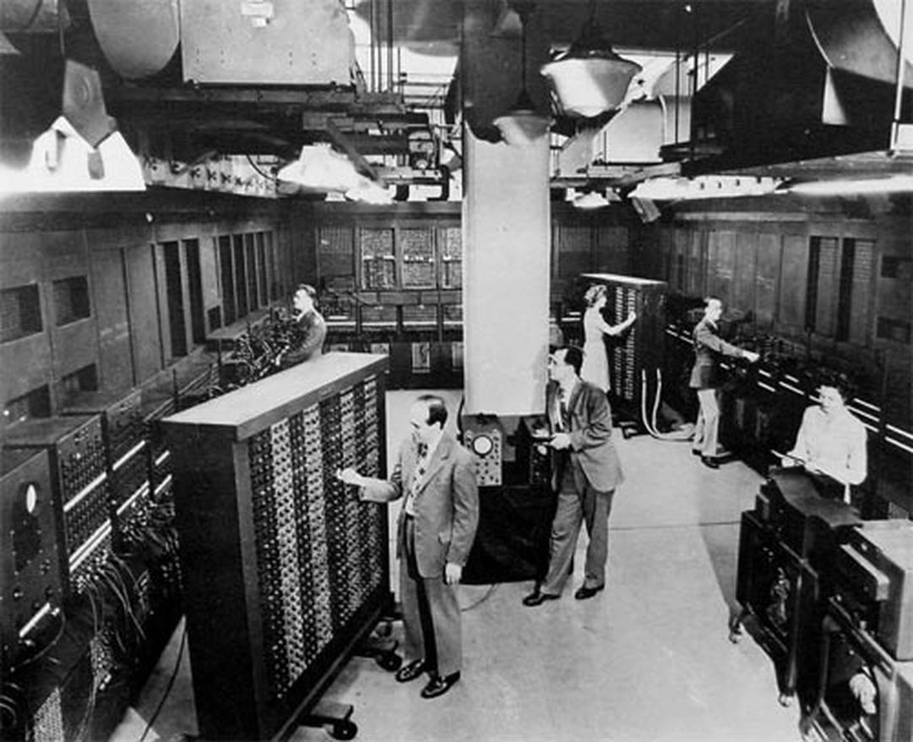
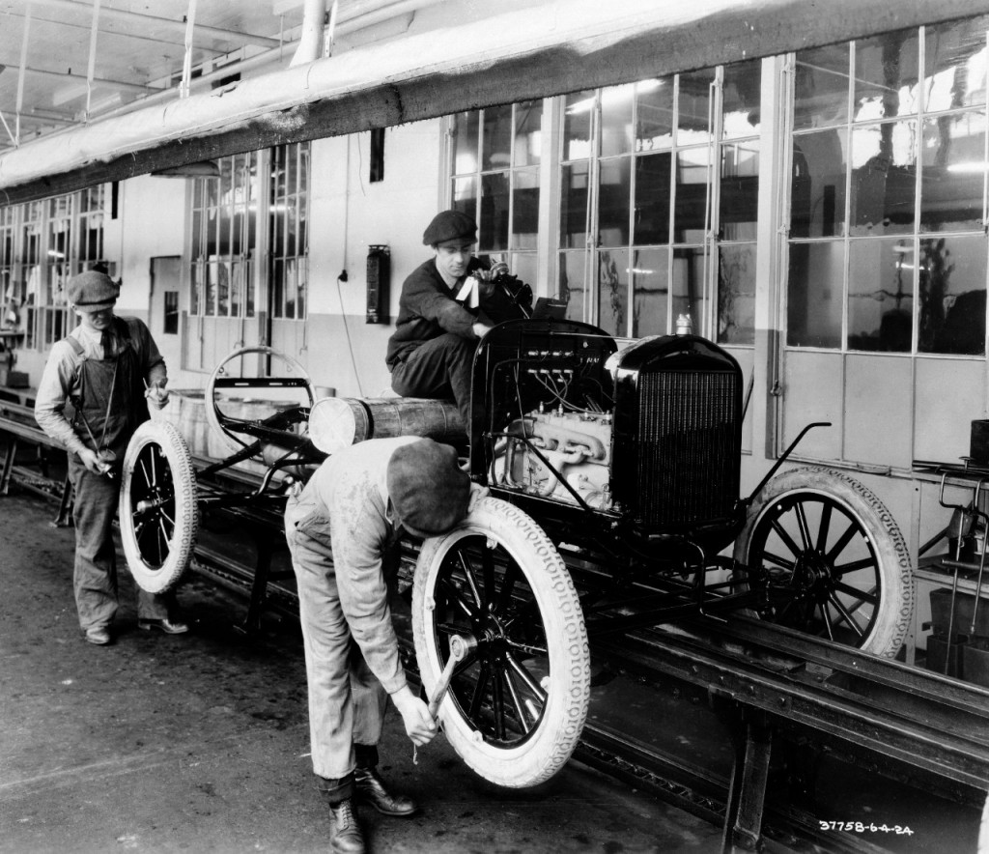
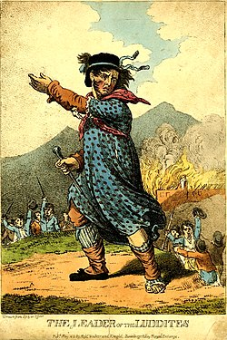
What do these pictures tell us about technology change, work, skills?

Slide 3
“Disruption” – Zeitgeist of Coming Decade
“Disruption has become the defining theme of doing business in the 21st century. This is happening at both a global level, via political turmoil and market volatility, and at an industrial one with technology transforming business models, creating huge challenges and new opportunities in every market.”
“Rapid technological change is causing enormous shockwaves. It’s fundamentally disrupting the social fabric we’ve been used to for decades: the delicate, fragile, interwoven relationships between the state, citizens, civil society and business, and the way we learn, work and communicate. We are only just at the beginning of it.”
(Duncan Tait, CEO Fujitsu Americas and EMEIA)

Slide 4
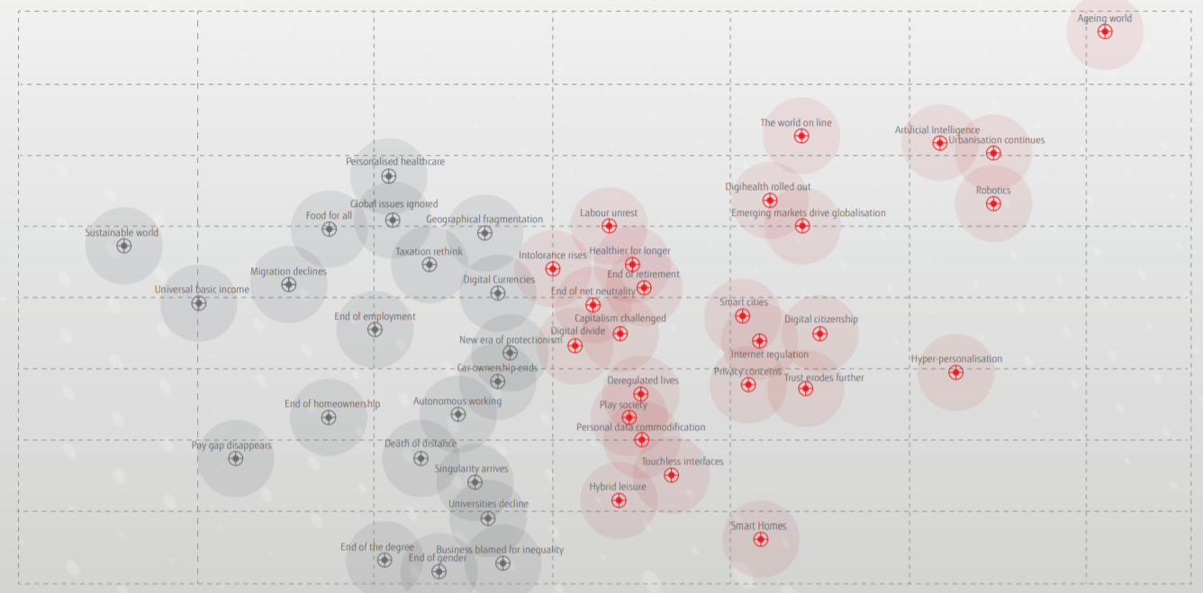
50 trends rated for certainty and impact (fujitsu)
Certainty
Impact
Impact
Certainty
The Trends Map is built upon two axes, certainty (x-axis) and impact (y-axis). The further along the impact axis a trend sits, the surer we can be that it will take hold. The further along the certainty axis a trend sits, the bigger the impact it would make on the world.

Slide 5
Artificial intelligence and Robotics
Driven by advances in artificial intelligence (AI) and robotics, automation has the capacity to transform workplaces, economies and society.
The autonomy provided by increasingly sophisticated AI will see robotic capabilities increase drastically, with less need for human supervision.
In the short term, more jobs in manufacturing and industry will be taken by machines, with more ‘white collar’ jobs (analytics, legal clerks, customer service and retail) threatened in the next 10-15 years.

Slide 6
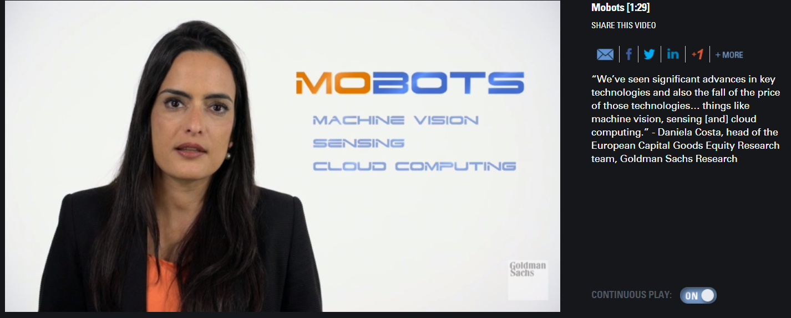
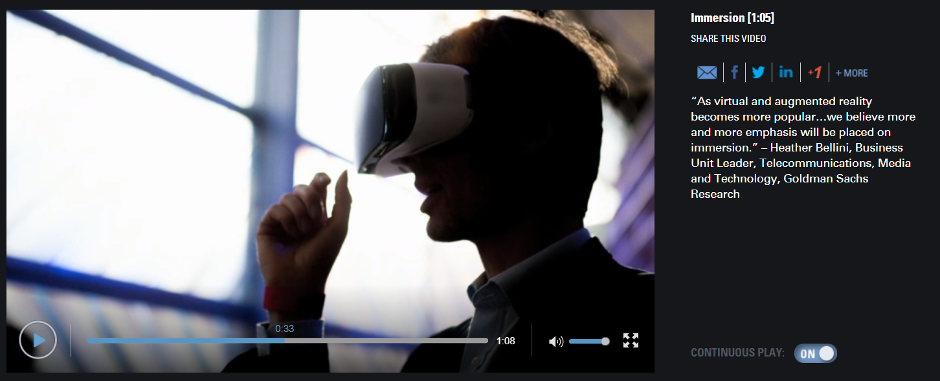

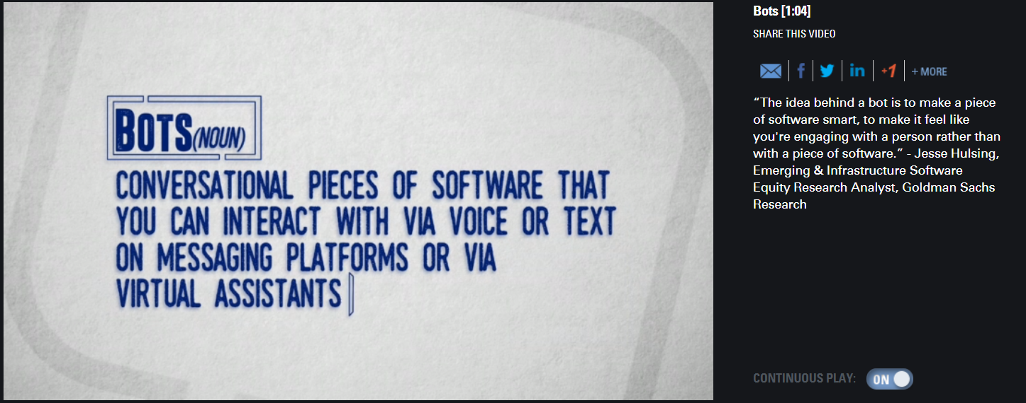
Mobots
Immersion
eSports
Bots

Slide 7
Future of Work
UKCES Study 2014
Trends point to changes in business and society - significant impact on UK jobs and skills:
Emerging economies stronger in global production chains;
Demographic change and migration changing face of workforce;
Technological developments dissolving boundaries between sectors and changing modes of working;
Organisational structures in business evolving, becoming more flexible and more networked.
“These rapid, complex shifts are affecting labour markets around the world, constantly challenging the balance of supply and demand, and labour market and education policies.”

Slide 8
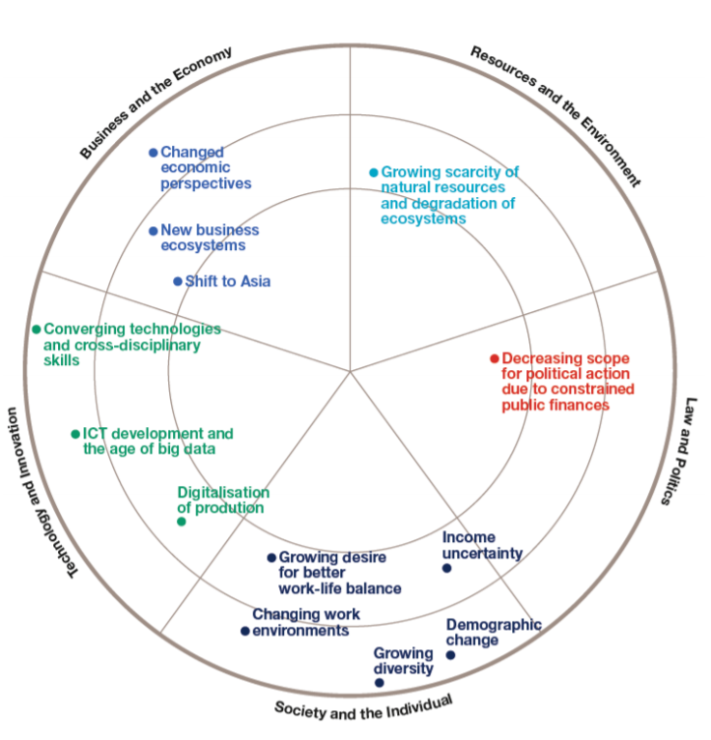
13 Trends driving future of UK Skills and Jobs
(UKCES report 2014)
Growing diversity
Converging technologies/ cross disciplinary skills
Demographic change
Changing work environments
Changed economic perspectives
ICT Developments / big data
New business eco-systems
Growing scarcity of natural resources
Income uncertainty
Growing desire for better work life balance
Shift to Asia
Digitalisation of production
Decreasing scope for political action due to constrained public finances

Slide 9
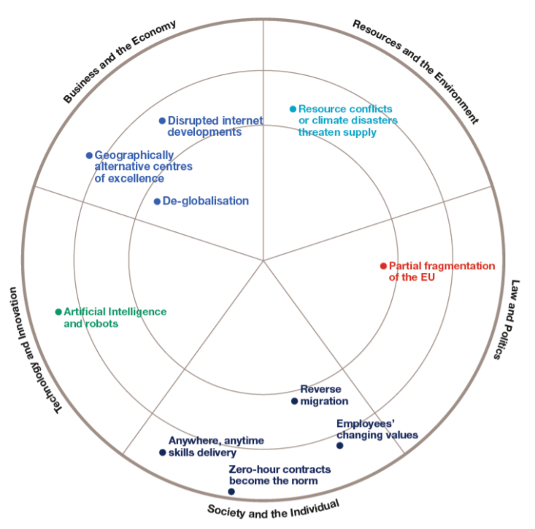
Ten key disruptions impacting future jobs and skills in UK (Foresight report 2014)
Reverse migration
Changing values of employees’, where workers select employers on the basis of alignment with their own values
Zero-hour contracts, and similar flexible arrangements, become the norm
Anytime, anywhere skills delivery, enabled by virtual and peer-to-peer learning
Artificial intelligence (AI) and robots, penetration of AI and automation into highly skilled occupations
De-globalisation
Geographically alternative centres of excellence, the UK’s leading position in key economic sectors is lost to high growth economies
Disrupted Internet developments due to cyber crime
Resource conflicts or climate disasters threaten supply
Partial fragmentation of the EU.

Slide 10
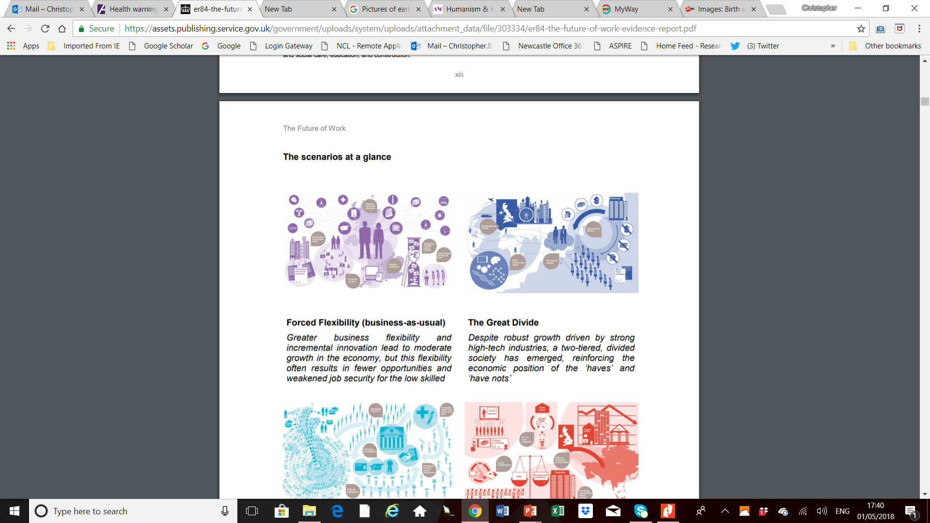
Four Scenarios in Business to 2030
Forced flexibility (business as usual) – greater flexibility, incremental innovation, moderate growth but this flexibility often results in fewer opportunities and weakened job security for the low skilled
The Great Divide – despite robust growth driven by strong high tech industries, a two tiered, divided society has emerged, reinforcing the position of the ‘haves’ and ‘have nots.’
Skills Activism – technological innovation drives the automation of white collar work and brings large scale job losses and political pressure, leading to an extensive government-led skills programme
Innovation Adaptation – In a stagnant economy, improved productivity is achieved through a rigorous implementation of Information and Communications Technology solutions

Slide 11
Active Ageing and Social Partnership
Matt Flynn and Chris Ball

Slide 12
Context of Ageing Workforce
Aging population – rising life expectancy and falling fertility – big gap in 40s
Government incentivising working longer
Many people want to work longer and are capable
Caring responsibilities
Rising self employment (but often not by choice)
New specialised roles to support older workers, but these are rare (mentoring, quality assurance, training, consulting)
Significant group of highly qualified older people choose to “downshift” to less stressful roles
Employers need to plan to manage and motivate

Slide 13
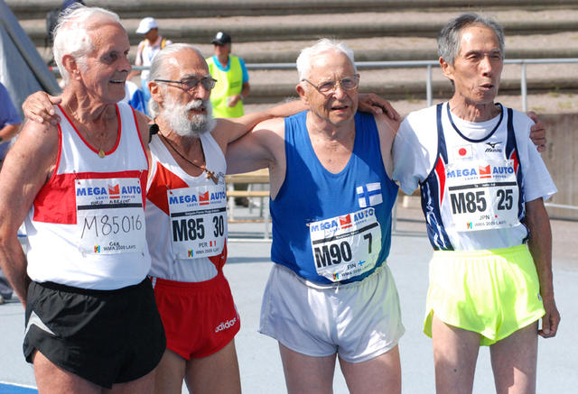
What has changed?
Rising healthy life expectancy
Changing retirement patterns
EU targets to increased older workers’ labour market participation
Employment Equality (Age) Directive 2001 and 2006 Age regulations (Abolition of mandatory retirement)
Pension changes
  Rising state pension ages
  Moves from DB to DC schemes – increased risks
  Elimination of early retirement routes (national and organisational)
  Creation of late retirement incentives

Slide 14
What can help?
Healthy workplaces
  Job and workstation design
  Autonomy and job control
Flexible working hours
  Not just part-time work
Skills and training
  Lifelong Learning and Intergenerational mentoring
Recruitment
  Making use of 500k older jobless labour force
Performance management and appraisals
  Difficult conversations
  Constructive conversations

Slide 15
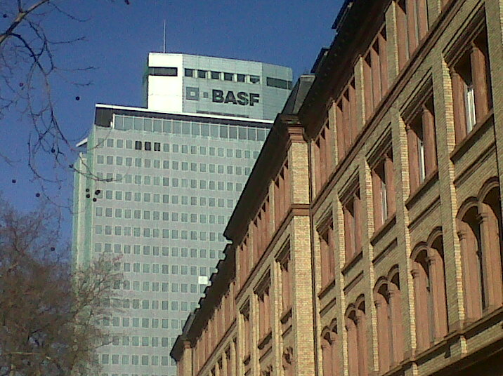
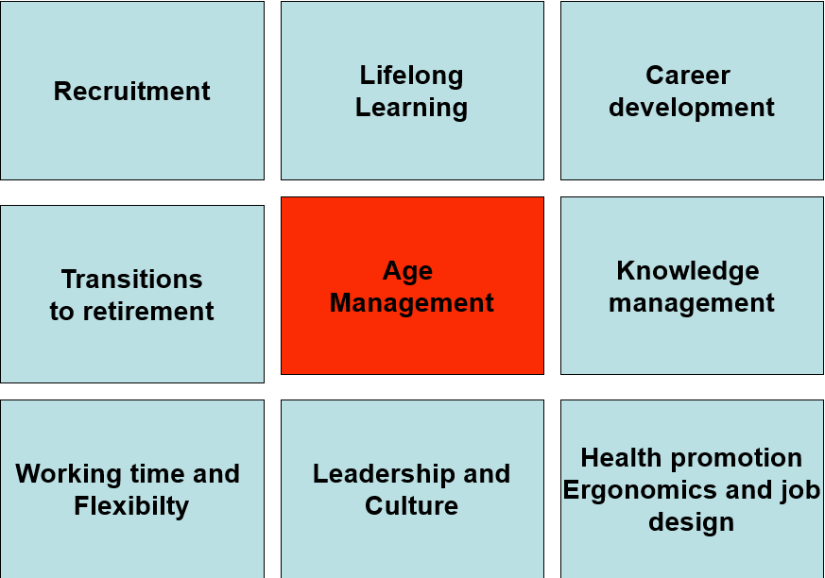

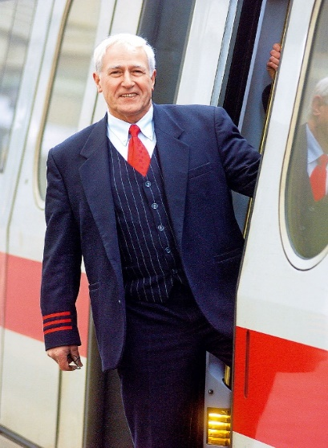
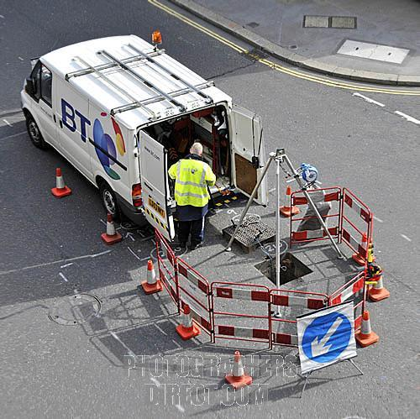
What does “good” look like?

Slide 16
About the ASPIRE project
European Commission funded
How social partners (unions and employers) engage on workforce active ageing
Aims and objectives:
  develop, pilot and embed human resource management (HRM) interventions which support older workers
  reconcile competing intergenerational interests
  investigate ways in which social partners are shifting from an early retirement toward active ageing orientation
  Provide resources (online and training) to support social partners in promoting active ageing

Slide 17
How can social dialogue help?
Giving older workers voice on their work environments
Balancing workforce demands and employees expectations
Sharing good practice between and within organisations
Investigating and innovating jointly
Facilitating dialogue at the:
  Organisational level- Developing, piloting and embedding active ageing HRM
  Workplace level- Managing change in the workplace
  Individual level- Supporting older workers and their managers discuss plans

Slide 18

Our questions to you?
What does your organisation think about a multi-generational and diverse work places?
What is being done now to support older workers and promote active ageing?
Is there anything that could be done better?
What do you think older workers want in terms managing extended working life?
How can social dialogue help?

Slide 19
We will welcome your comments
Professor Matt Flynn and Dr Chris Ball
Centre for Research on Older Workers
Business School
Newcastle University,
NE1 7RU
www.adapt.it/aspire www.agediversity.org
@agediversity @crystal_balls Christopher.Ball@Newcastle.ac.uk
www.huffingtonpost.co.uk/author/chris-ball

