Slide 1
Active ageing at company level: A need for a participatory approach
Izabela Warwas
Piotr Szukalski
University of Lodz

Slide 2
What is active ageing?
Active ageing is a new way of thinking about population ageing problem based on constructionist approach to individual life.
Main assumption of the approach is definition of individual ageing as social construct, i.e. a belief societies could shape life-course of individuals by norms and institutions.

Slide 3
Normative model of life course
A normative model of life course is based on age norms
Age norm – an expectation on what (what type of cereers and events) end when (cultural age deadline) should happen in somebody’s life at some stages if the life is to be assessed as successful

Slide 4
Personological paradigm of life course vs institutional one
Personological paradigm – individuals life is shaped by his/her individual choices, preferences, values, access to resources
Institutional paradigm – individual life is shaped by social institutions acting at different levels, and by social norms
The truth is in-between

Slide 5
Active ageing
Assumption:
Public and social institution could and should affect ageing individuals to enable them be more satysfied with their lives.
WHO definition – Active ageing is the process of optimizing opportunities for health, participation and security in order to enhance quality of life as people age.
Reality – public authorities are mainly interested in prolonged economic activity

Slide 6
Why companies are interested in active ageing?
Good narrative to encourage workers to professional career prolongation
Good narrative to convict themselves to introduce new management techniques

Slide 7
Active ageing policy at company level
All activities undertaken by company to prolong working careers of its older workers, to recruit new ones, and to help them to prepare for their own old age.
Active ageing – many similarities to age management but we could’n identify the two terms:
The second is mainly based on professional career, the first on a set of careers.

Slide 8
How to introduce active ageing policy?
In general public active ageing policy is based on vision of a better society but even when provided by the-so-called „besserwissers” (German: somebody who – according to him/her – knows better) should be consulted by end-users.
Including all beneficiaries is crucial to enhance efficiency of the policy.
Probably the same is truth in case of active ageing policy at company level.

Slide 9
Who are End-users at company level?
Older workers (5-10 years prior to pension)
Ageing workers (10-15 years prior to pension)
Managers
Owners
Unions
How to combine their expectations and interests?

Slide 10
End-users and age management (1)
(…) if someone decides that they would like to get skills from the area of assertiveness or anything else, they get signed in and we make them ready to benefit from that. People are not just workers, they are a complex being. It is not just about work. People have expectations and they want to develop and acquire new competences which are maybe not that useful in everyday work but they make family or social relations easier. [Emitel, training]

Slide 11
End-users and age management (2)
When it comes to the pension contract, some very good solutions can be found here for the organization, for the employee as they organize the period of several years before retirement and there is a sense of security and confidence of the employee, and on the other hand the possibility to plan such activities when it comes to the company.
From the management psychologist point of view, it is very important to write down this contract in detail and to keep it because you cannot sign something and then withdraw from it. [Phillipe Morris. Preceding activities, years before retirement]

Slide 12
End-users and age management
In 2012 when the employer was an American fund and with Polish capital, we managed to reach an agreement, because it was a conscious employer and the consent of shareholders was to introduce age management. The employer saw the way to face the creation of this tool and created intergenerational solidarity, which explains why this agreement has gained a rank in the workplace. [Agros Nova Collective Bargaining]

Slide 13
End-users and age management
There is need for flexibility, innovativeness (…). It is not necessary now for the employee to spend in the office 8 or 9 hours or for him to work from 7 in the morning until 3 in the afternoon. It is not the point anymore. So I am giving my employee this flexibility. If they wish to start at 10:00- be my guest. They will stay longer if there is need for that. If they wish to do home office a couple of days during a month, it also is possible. [Japan Tobacco International , Flexible working]

Slide 14
Interlocutors noticed many barriers and facilitators of the development of active aging in Poland. They were relatively the easiest to give examples from the macroeconomic level, concerning the labor market and national regulations.
Respondents showed quite a number of activities in response to the phenomenon of aging. Among them the most important were age management solutions. There are isolated examples of collective labor law.

Slide 15
Conclusion
Participatory approach vs. Besserwisser approach
Participatory approach is relatively not frequent in Poland
Discrepancy while intensity of social actors’ actions is analysed

Slide 16
Social partners unions employers
National level
National level
Regional level
Regional level
Company level
Company level

Slide 17
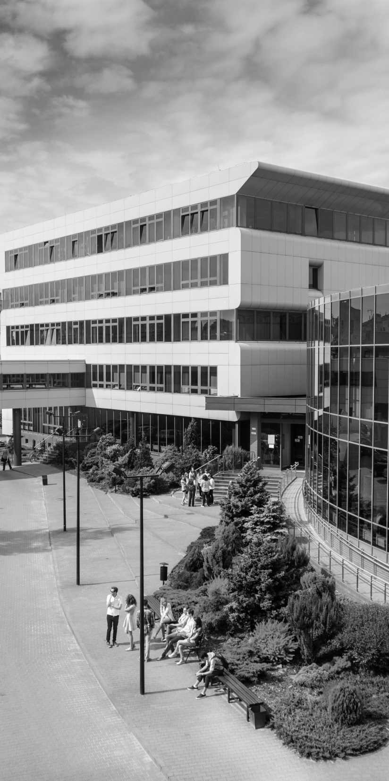
The Faculty of Economics
and Sociology
University of Lodz
Thank you for attention
izabela.warwas@uni.lodz.pl
piotr.szukalski@uni.lodz.pl
eksoc.uni.lodz.pl

