Slide 1
SoDiMa Social Dialogue for the Future of Manufacturing

Slide 2
Industry 4.0 Plan
The Industry 4.0 Plan, launched for the first time by the Ministry of Economic Development (MISE) in November 2015, has given life to an infrastructure of digital innovation with the aim of creating close interactions between researchers and companies, training and work, innovation and territories.
This network works around two fundamental organizations:
Competence Centers, which are research and innovation centers, linked to universities and companies, in order to develop the extremely high competences regarding 4.0 technologies;
Digital Innovation Hubs (DIH), supply services to companies, creating networks among the various actors involved in digital innovation.

Slide 3
Digital Innovation Hubs
DIHs stimulate and promote the culture of innovation, provide access for the companies to the “4.0 world”.
They are structured on a regional basis and work closely with the Associations of Confindustria.
What do they do?
Awareness and training of opportunities connected to 4.0 technologies, through seminars, workshops and visits to companies;
Assessment of the level of digitalization;
Orientation towards the innovation ecosystem: national and European competence centers, smart factories, light plants, universities, research institutions, FabLab, etc.

Slide 4
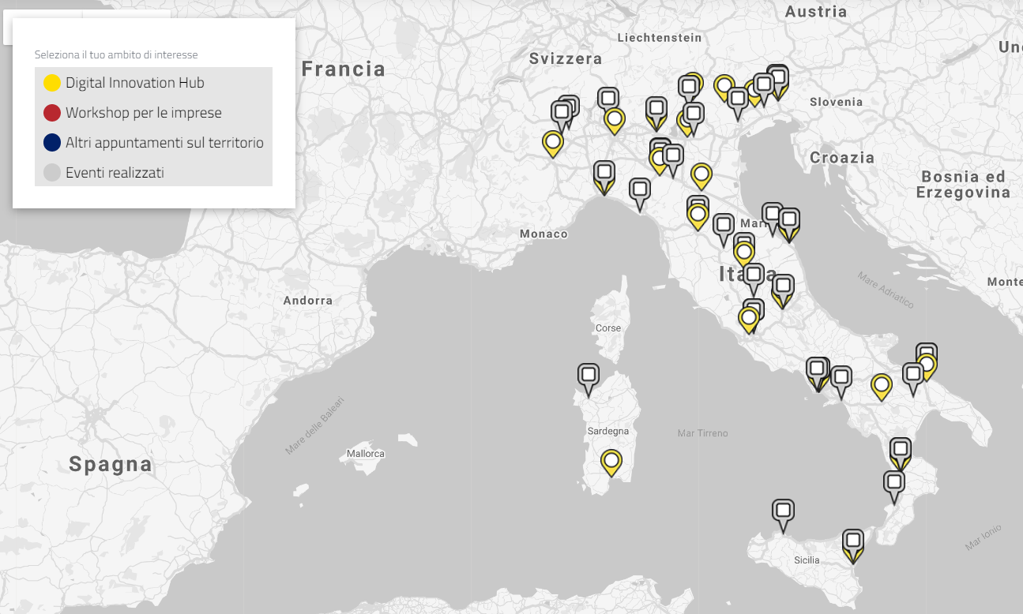
DIHs & Workshops
Notes:
Yellow markers

Slide 5
What are we doing for 4.0?

Slide 6
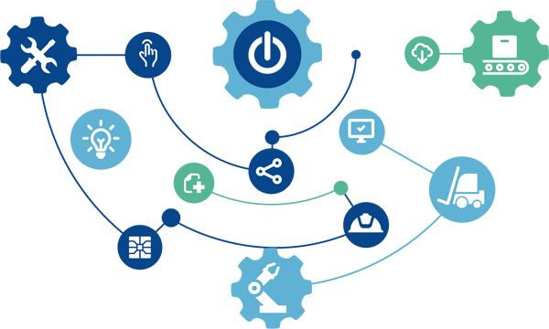
Task Force “Liberare l’ingegno”

Slide 7
Aims & Mission
In 2015, Federmeccanica set up the Task Force "Liberare l’ingegno", with the aim of "accompanying" Italian manufacturing companies on a path towards the full digitalization of manufacturing (Industry 4.0).
Aims:
Bridging structural gaps
Transferring awareness (awareness action)
Adopting a system approach
Team group:
Representatives of National and Territorial Associations
Companies & Entrepreneurs
Universities, Research centers & Experts

Slide 8
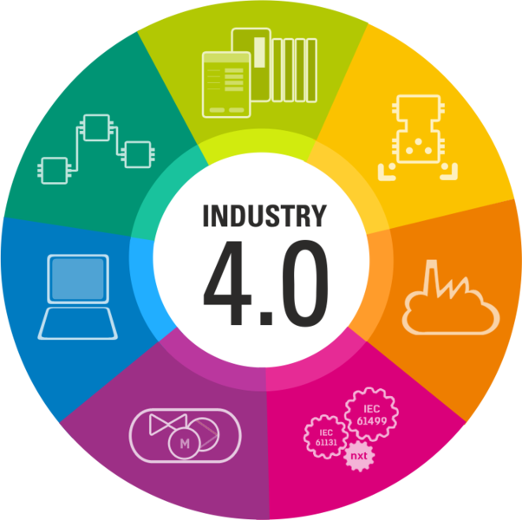
Task Force ACTIVITIES
Work Plan (2015)
Survey “Costruiamo insieme il futuro” (2016)
Webcast Industry 4.0 (2017)
“Ricomincio da…4” (2017/2018)
“Ricomincio da…4” Phase 2 (2019/2020)

Slide 9
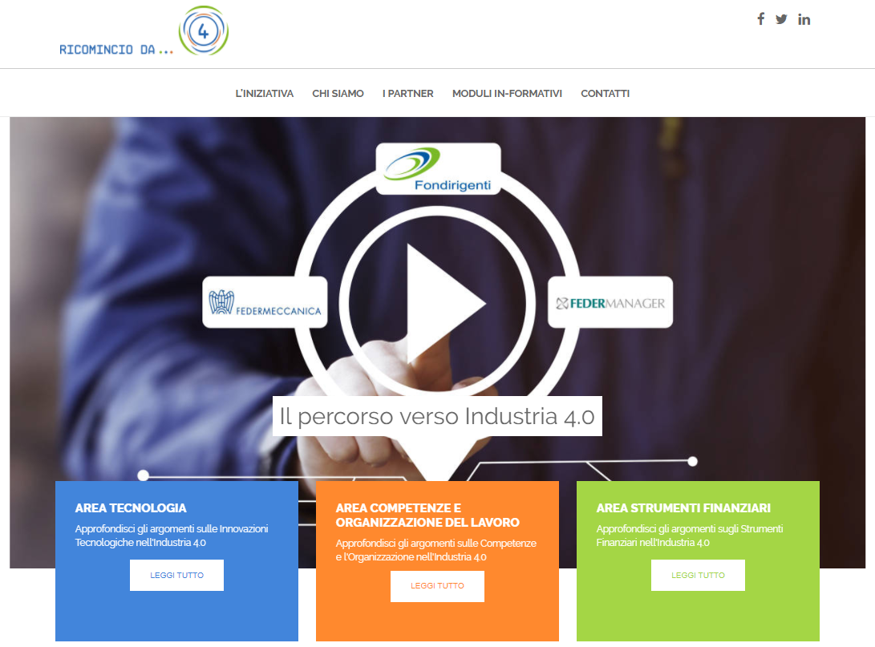
Ricomincio da … 4!

Slide 10
Key Stakeholders
Federmeccanica
Fondirigenti
Federmanager
Companies
Managers
Genesis idea and project design (Task Force “Liberare l’ingegno”)
Fund
Partner
More than 117 companies enrolled
More than 125 managers enrolled

Slide 11
Project’s aims and objectives
What?
Inform and train about Industry 4.0 topics
Inform&Train about:
Technologies
Skills
Work Organization
Financial tools
Business impacts
Who?
Entrepreneurs and Managers
How?
Effective and concrete communication
https://ricomincioda4.fondirigenti.it/

Slide 12
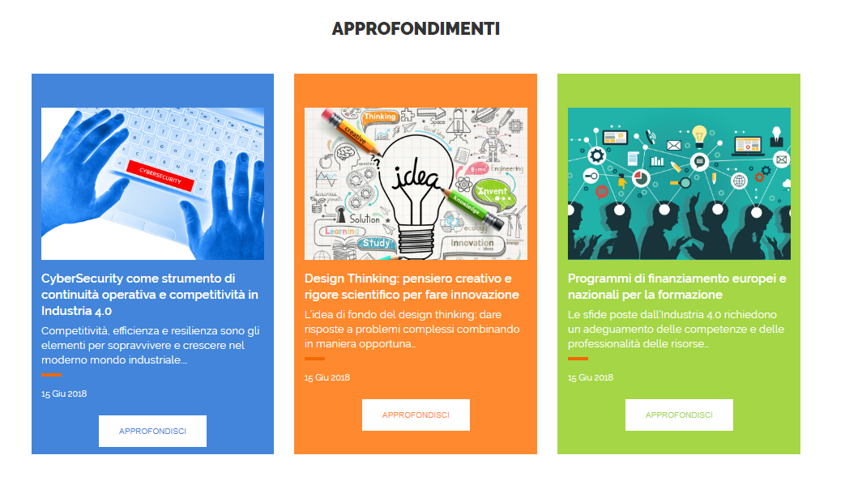
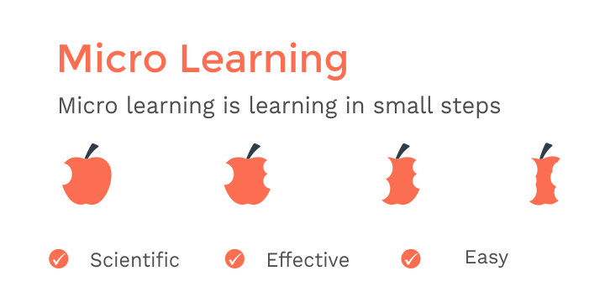
3 Key Phases
A first phase focused on:
- Detailed study
(video interviews; company best practices; authoritative contents; data)
- Virtual tour
(involving three innovative companies)
- Survey
A second phase focused on:
Micro learning
(flexible and self-directed training)
&
Self-evaluation

Slide 13
Phase 1
November 2017 – March 2019
6 modules to inform&train
Technologies | Skills | Organization | Financial tools
IoT | Skills related to technologies Soft skills (proactivity, team working, …) Training tools (skills balance, on-the-job training, ITS, DdR, …) | Holistic model | Italian Governament Incentives
Cloud, Big Data & Analytics |  | Workforce Analytics | European incentives
Simulation & Additive manufacturing |  | Collaborative Community | Incentives for skills development
Nanotech & smart materials |  | Smartworking | Regional incentives
Collaborative robotics & mechatronics |  | Swarm organisation | Start up and innovative PMI incentives
Cybersecurity |  | Active ageing | Incentives for training

Slide 14
Phase 1
August 2018
1,185 followers on Twitter
703 registrations
115 articles
125 managers
25 best practice companies
6 video interviews
1,902 likes on Facebook
5,000 web site interactions per month
117 companies

Slide 15
Phase 1: Survey
May 2018
This survey aimed to investigate:
The degree of adoption of the 10 enabling technologies inserted in the Industry 4.0 Plan;
The degree of utilization of the incentives inserted in the Industry 4.0 Plan;
The degree of diffusion among companies of the 4.0 competencies.
https://ricomincioda4.fondirigenti.it/

Slide 16
Phase 1: Survey
May 2018
INSIGHTS FROM COMPANIES
Medium - high level of digitalization (78%);
65% of companies declared to adopt at least one of the enabling technologies;
A greater tendency - compared to 2015 - to invest in 4.0 technologies,
especially in Collaborative Robotics, IoT, and Cyber Security;
Hyper Depreciation and Research & Development Tax Credit are the
most appreciated incentives;
Analytics, supply management, and digital are the most widespread
4.0 skills.
https://ricomincioda4.fondirigenti.it/

Slide 17
Phase 2
February 2019 – July 2020
We are working for a micro-learning platform in order to enhance and develop digitalization skills of manager and entrepreneurs.

Slide 18
“Ada, Alan e i misteri dell'IoT”: a book on 4.0 world
A story using illustrations to promote the discovery of new technologies (cobots, algorithms, AI, additive manufacturing, etc) to young readers. The very user-friendly technologies are explained in the book, demonstrating what is behind the immediate appearance.
The book offers a lively and engaging interpretation of the current digital revolution, and explains how not only is the labour market and production processes changing, but also our daily life.
Furthermore, an appendix illustrates the technologies mentioned and the biography of illustrious inventors from which the characters take their names.

Slide 19
Roadshow Meccanica 4.0
The “Roadshow Meccanica 4.0” is aimed at facilitating the identification of Mechanics and Mechatronics needs and providing support to companies in the digital transformation process.
Through the experience of those who have already changed their way of doing business, we talk about the advantages deriving from the adoption of new technologies, digital culture, new skills needed, incentives, etc.

Slide 20
Thank you for your attention!

